Slide 1

PS REMOTING
FROM ZERO to LOCKDOWN!

Slide 2

Who am i?
Day Job: Sysadmin ✧ AD Engineer ✧ PowerShell Fanatic
Co-Leader: Research Triangle PowerShell Users Group (@RTPSUG)
Contributor: PowerShell Conference Book vol. 1 & vol. 2
PowerShell.org: Director of Community Engagement
Blog: www.networkadm.in
Writer: 4sysops.com
Twitter: @MikeKanakos
Email: mkanakos@gmail.com

Slide 3
Agenda for today
What is PSRemoting?
How does it work and Is it safe?
PowerShell Authentication
WMI vs CIM
How to Enable Remoting
Controlling Access to Remote Nodes
Logging PS Activity

Slide 4

PS Remoting
From Zero to Lockdown!

Slide 5
What is PSRemoting?
PowerShell Remoting is a feature in PowerShell that lets admins securely run commands on remote systems
PS Remoting runs via the Windows Remote Management (WinRM) service
WInRM uses the Web Services for Management (WS-MAN) protocol to make secure, encrypted connections between computers
WS-Man is an open standard for exchanging management data securely

Slide 6



How Does Psremoting work?
http 5985 / https 5986
Encrypted connection (256 bit key)
Local PowerShell session authenticates against remote client. - Enter-PSSession
- Invoke-Command
- Any CIM cmdlets
01
Commands typed on the local system are sent to a remote computer and executed locally ON THE REMOTE SYSTEM.
03
The remote system EXECUTES the commands locally and sends the results back to the local system.
04
Identity confirmed. Privileges granted based on local group membership
PS session on remote system via WS-MAN / WinRM
02

Slide 7
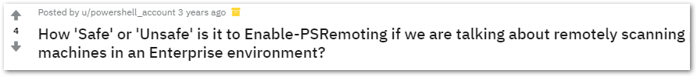
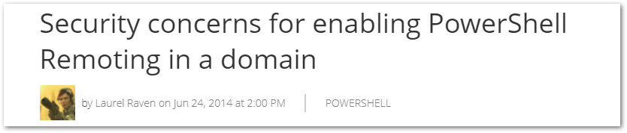
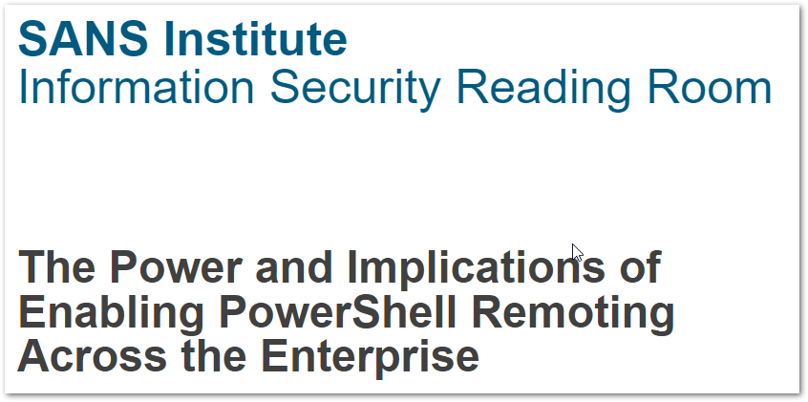
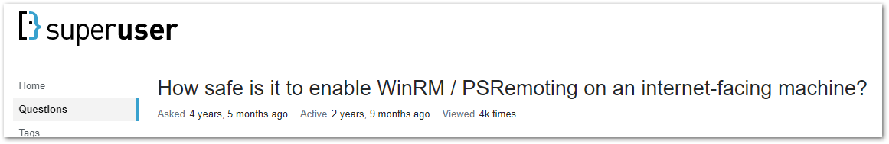
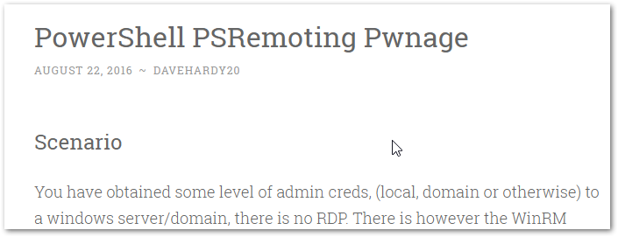
Is PSREMOTING SAFE?

Slide 8
Who needs malware?
IBM says most hackers just PowerShell through boxes now, leaving little in the way of footprints
IBM's X-Force, found that in 2018 just 43 percent of the attacks it analyzed utilized any sort of locally installed files. Rather, the hackers utilized PowerShell scripts to execute their dirty deeds in memory without significantly touching file systems, if at all.

Slide 9
How is Powershell used by attackers?
Attackers mainly use PowerShell as a downloader and for lateral movement
Organizations often don’t enable monitoring and extended logging on their computers, making PowerShell threats harder to detect
Currently, most attackers do not use obfuscated PowerShell threats. Only eight percent of these threat families implemented obfuscation

Slide 10
Is PSREMOTING SAFE?
Yes!
…but why?

Slide 11



PSREMOTING is the connection & HANDSHAKE between NODES….

Slide 12
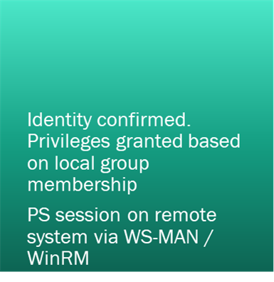
Powershell authentication
01
02
PS Remoting was designed to work with Active Directory
Authentication occurs using Kerberos for AD Domain-joined computers
Authentication occurs using NTLM for workgroup computers
Local PowerShell session authenticates against remote client. - Enter-PSSession
- Invoke-Command
- Any CIM cmdlets

Slide 13
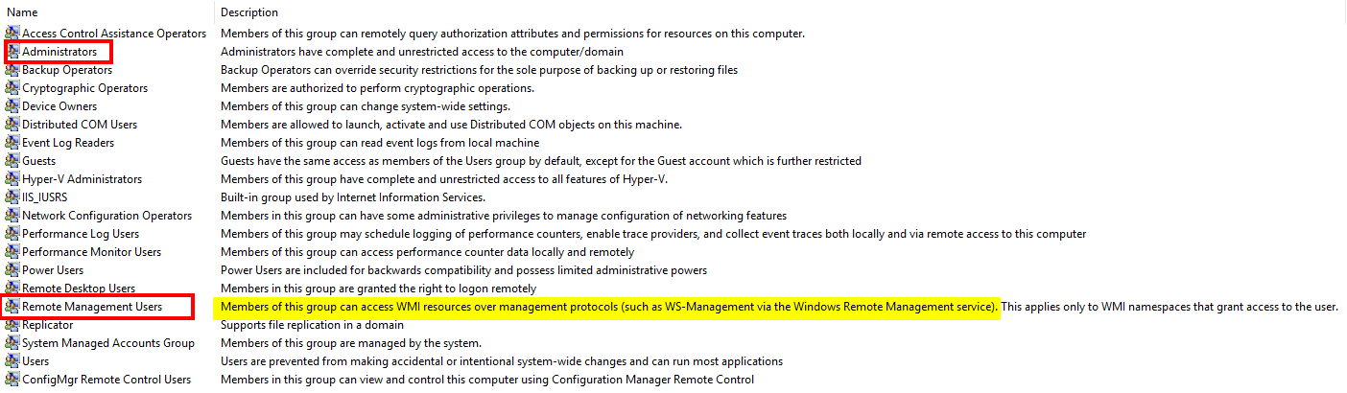
Powershell authentication

Slide 14
CIM vs WMI: What’s the difference?
CIM is WMI and WMI is CIM. What? It’s confusing….
WMI is Microsoft’s version of an open standard called Common Information Model (aka CIM)
Uh ok…. So what’s different between WMI and CIM?

Slide 15
CIM vs WMI: What’s the difference?
When CIM was created, there was no specification for networking
Microsoft chose to use DCOM and RPC as the method to send and receive data. Their version of the standard was called WMI
In 2012, MS released a new version of WMI. But the knuckleheads didn’t give it a unique name!
This new version uses WS-MAN instead of DCOM & RPC.
Many people called this new version CIM (or WinRM). The name stuck…

Slide 16
CIM vs WMI: What’s the difference?
CIM:
Firewall friendly. Only needs 2 ports open
HTTP 5985, HTTPS 5986
Authentication via Kerberos
WS-MAN
WMI:
Not firewall friendly
TCP 135,445 must be open
Also, dynamic assigned ports between 1024 and 1034
DCOM & RPC

Slide 17
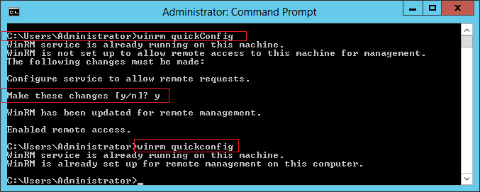
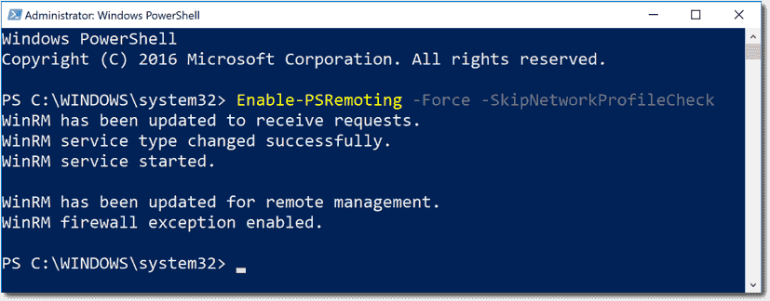
Enabling PSREMOTING VIA POWERSHELL

Slide 18
Enabling PSREMOTING VIA GROUP POLICY
Enabling WINRM Service
Setting WINRM to Auto Start
Allow WinRM through the client firewall

Slide 19
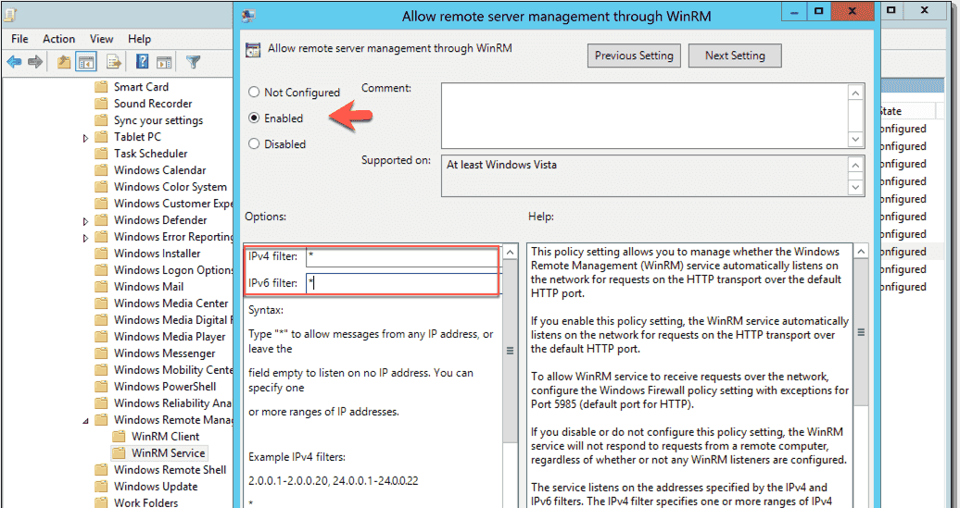
Enabling PSREMOTING VIA GROUP POLICY
Computer Configuration > Policies > Administrative Templates > Windows Components > Windows Remote Management (WinRM) > WinRM Service

Slide 20
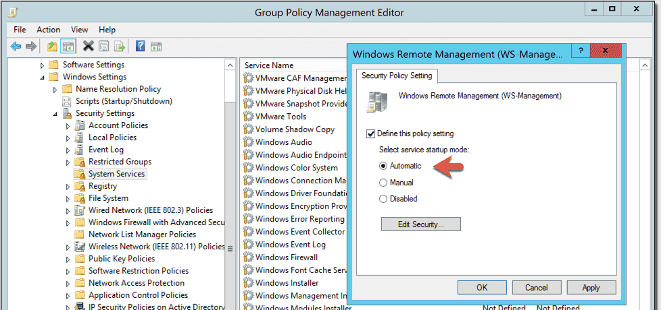
Enabling PSREMOTING VIA GROUP POLICY
Computer Configuration > Policies > Windows Settings > Security Settings > System Services > Windows Remote Management (WS-Management)

Slide 21
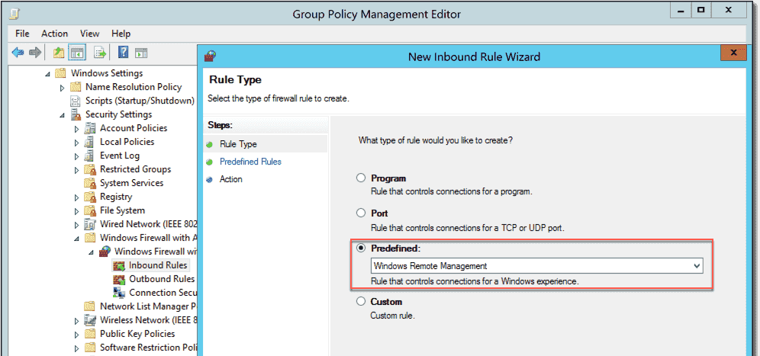
Enabling PSREMOTING VIA GROUP POLICY
Computer Configuration > Policies > Windows Settings > Security Settings > Windows Firewall with Advanced Security

Slide 22
Controlling access to remote nodes
Remote Management Users = Read Access to client

Slide 23
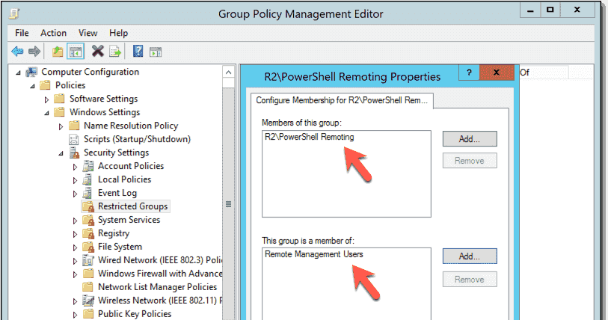
Controlling access to remote nodes
Computer Configuration > Policies > Security Settings > Restricted Groups

Slide 24
PSRemoting & IP Filtering

Slide 25
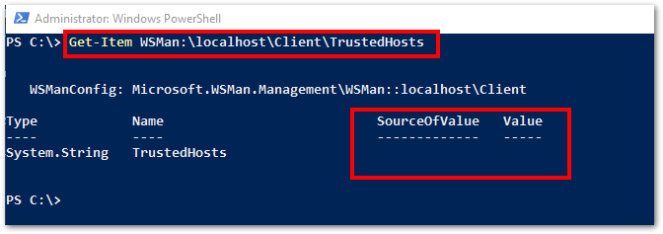
Trusted hosts

Slide 26
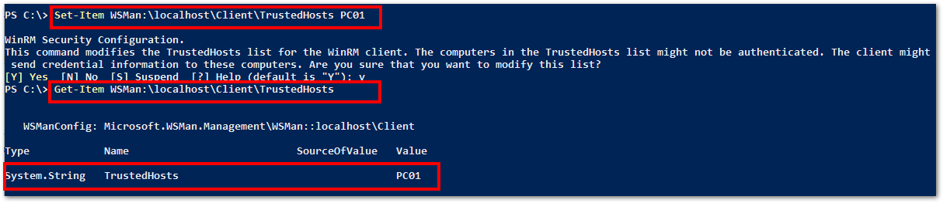
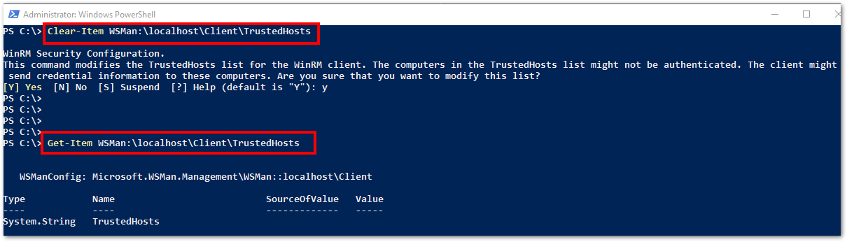
Trusted hosts

Slide 27
Enabling PSREMOTING: Summary
Enable WINRM Service and set to auto start
Configure Windows Firewall Exception
Decide who gets access
Decide where connections can be initiated from
Decide how you will do all of above (cmd line / GPO or both)

Slide 28
Powershell Logging
Module Logging
Script Block Logging
Transcription

Slide 29

Powershell Logging: Module LogginG
Module logging grabs activity related to specific modules Example: logging all activity from the Active Directory Module cmdlets
Events are written to the Windows PowerShell log
Can produce a large volume of events. Increase log size to 1 GB if possible

Slide 30
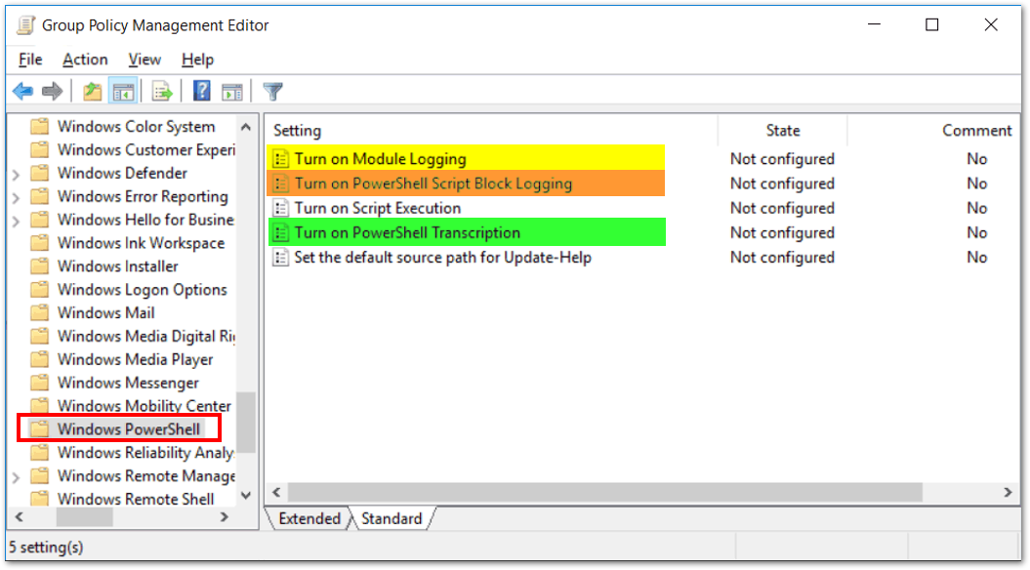
Powershell Logging: Module LogginG
Computer Configuration > Policies > Administrative Templates > Windows Components > Windows PowerShell

Slide 31
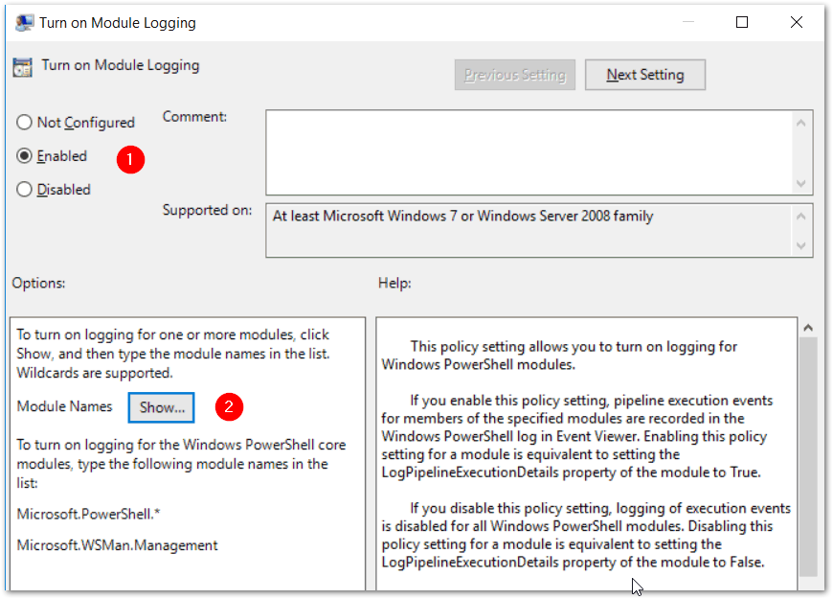
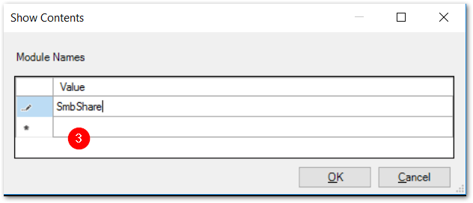
Powershell Logging: Module LogginG

Slide 32
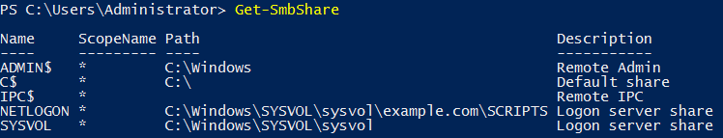
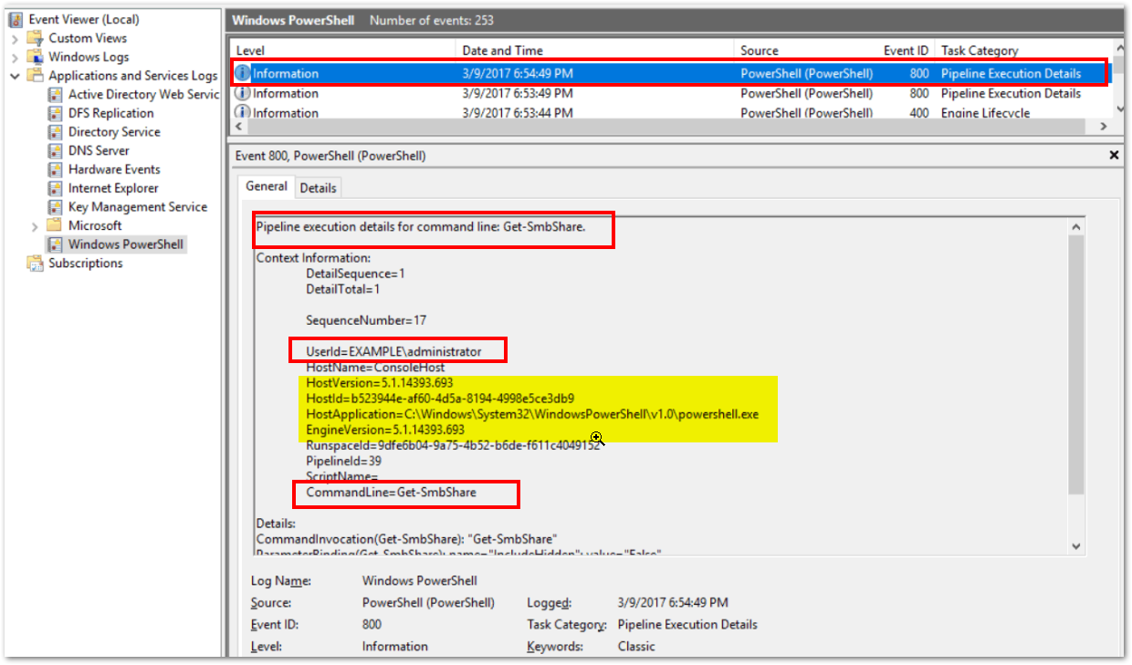
Powershell Logging: Module LogginG

Slide 33

Powershell Logging: Script block LogginG
Script Block logging records blocks of code as they are executed by the PowerShell engine
Events are written to the Windows PowerShell log (Event IDs# 4104, 4105 & 4106)
PowerShell 5.0 automatically logs code blocks if the block’s contents match on a list of suspicious commands or scripting techniques, even if script block logging is not enabled.
Produces less logs than Module Logging but still can be noisy.

Slide 34
Powershell Logging: SCRIPT block Logging
Computer Configuration > Policies > Administrative Templates > Windows Components > Windows PowerShell

Slide 35
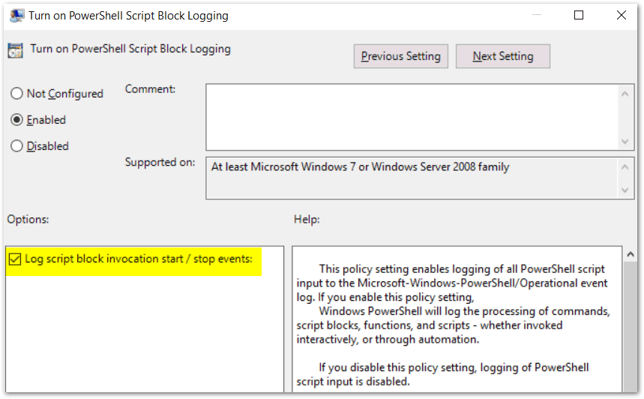
Powershell Logging: SCRIPT block Logging

Slide 36
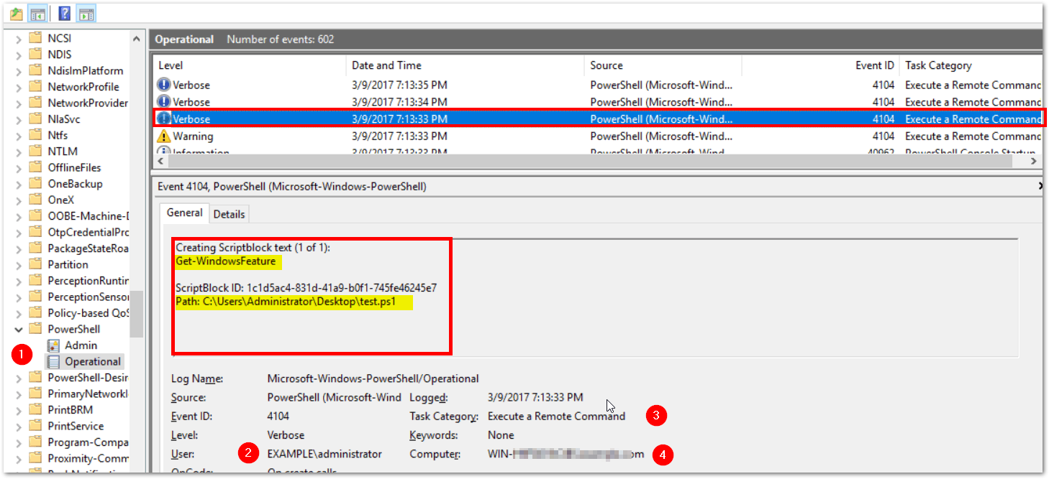
Powershell Logging: SCRIPT block Logging

Slide 37
Powershell Logging: TRANSCRIPTION
Transcription creates a unique record of every PowerShell session, including all input and output, exactly as it appears in the session.
Transcripts are written to text files, broken out by user and session.
WARNING: Transcription will capture passwords to the log in clear text!

Slide 38
Powershell Logging: TRANSCRIPTION
A common config for transcription is to write the logs to a local folder on each pc you want to capture history on.
Then, create a scheduled task that sweeps the logs off each machine into a share on a server once a day.
Finally compress the text files in a daily zipped archive.

Slide 39
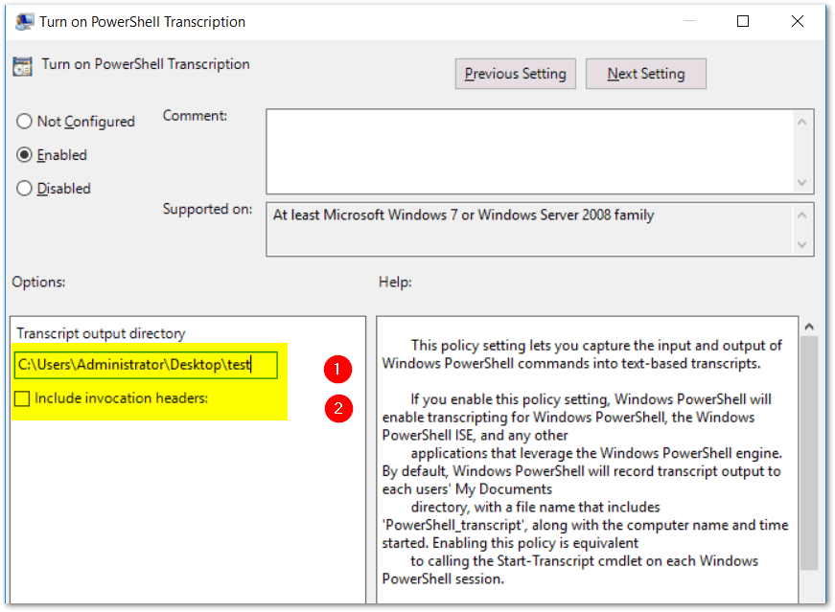
PowerShell Logging: Transcription

Slide 40
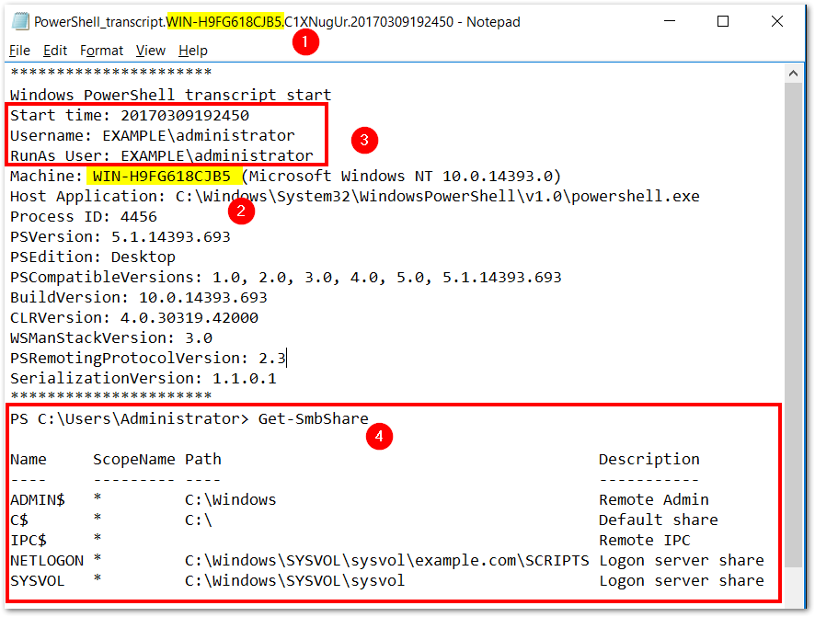
PowerShell Logging: Transcription

Slide 41
PSLogging: Summary
Three different logging options
Two options write to event logs
Transcription produces flat text files
Logging can fill up the eventlog quickly. Increase log size to 1GB or greater if possible
The right combination of logging is determined by you

Slide 42
PS REMOTING: What ELSE?
Certificates & SSL encryption
I’ve talked almost exclusively about authenticating users
SSL & certs verify computer identities
SSL & Certificates allow PowerShell remoting to use HTTPS port 5986 in addition to HTTP port 5985

Slide 43
PS REMOTING & LOGGING: Wrapping it all up
How secure PowerShell Remoting is depends on your security posture on your end nodes
PS Remoting uses secure protocols and AD authentication
PS Remoting can be configured easily via Group Policy
You can capture nearly every PS command typed into a PowerShell cmd prompt from any PC in your domain if you choose so. But doing so has an impact.
There is no one size fits all setting for PS Remoting & Logging
PS Remoting Is Safe and you should be enabling it!

Slide 44

PS Saturday: Raleigh
NC State Campus: Sept 21st & 22nd
18 speakers
Sunday: CyberOps & PowerShell 6 hr deep dive on offensive & defensive tactics
www.rtpsug.com/pssaturday

Slide 45
Thank you !

